Slide 1


CITS1003 Introduction to Cybersecurity [7] Incidents exercises
Dr Garrison Gao

Slide 2
Incident Analysis and Modelling
ADTool
CALDERA

Slide 3
ADTool
What is ADTool?
ADTool, short for Attack-Defense Tree Tool, allows a user to model and analyze attack-defense scenarios using attack-defense trees.
Attack-Defense tree is an extension of attack tree by including not only the actions of an attacker, but also possible counteractions of a defender.

Slide 4
ADTool
Installation
In a windows OS, download JDK (Java Development Kit):
Filename: jdk-23_windows-x64_bin.exe
https://www.oracle.com/java/technologies/downloads/
Install JDK
Double click the exe file

Slide 5
ADTool
Installation
Download JDK
Install JDK
Download ADTool: https://satoss.uni.lu/members/piotr/adtool/
Filename: ADTool-1.4-jar-with-dependencies.jar

Slide 6
ADTool
Installation
Download JDK
Download ADTool
Run the tool
Open PowerShell from the directory where the tool is downloaded
Run this command: java -jar ./ADTool-1.4-jar-with-dependencies.jar

Slide 7
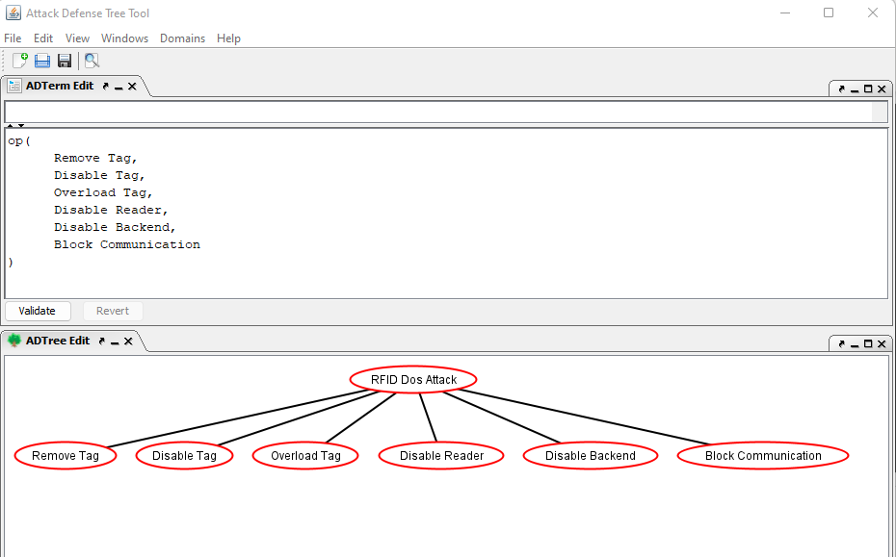
ADTerm
ADTree

Slide 8
or proponents

Slide 9
or proponents
or
proponents

Slide 11
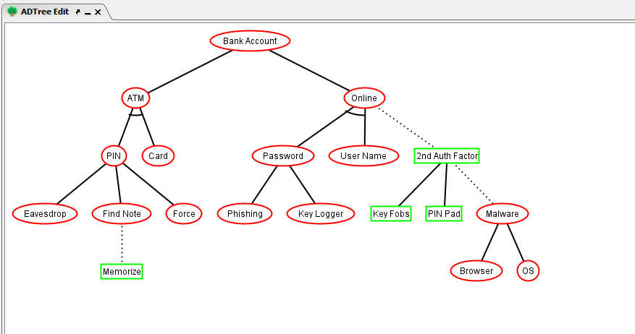
or proponents
op
op
op

Slide 12
op: or proponents
ap: and proponents
ap
?
op
op
?
?
op
?

Slide 13
op: or proponents
ap: and proponents
ap
?
opponent
op
op
oo: or opponents
?
opponent
opponent
op
?
opponent

Slide 14
op: or proponents
ap: and proponents
ap
cp
opponent
op
op
oo: or opponent
co: counter opponent
opponent
opponent
op
cp: counter proponent
opponent

Slide 15
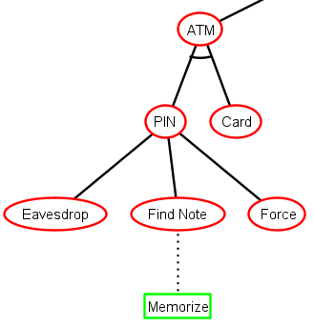
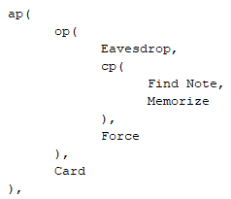

Slide 16
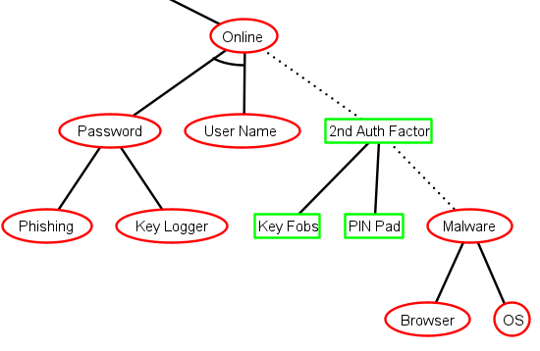
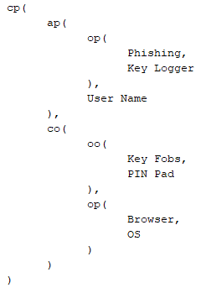

Slide 17
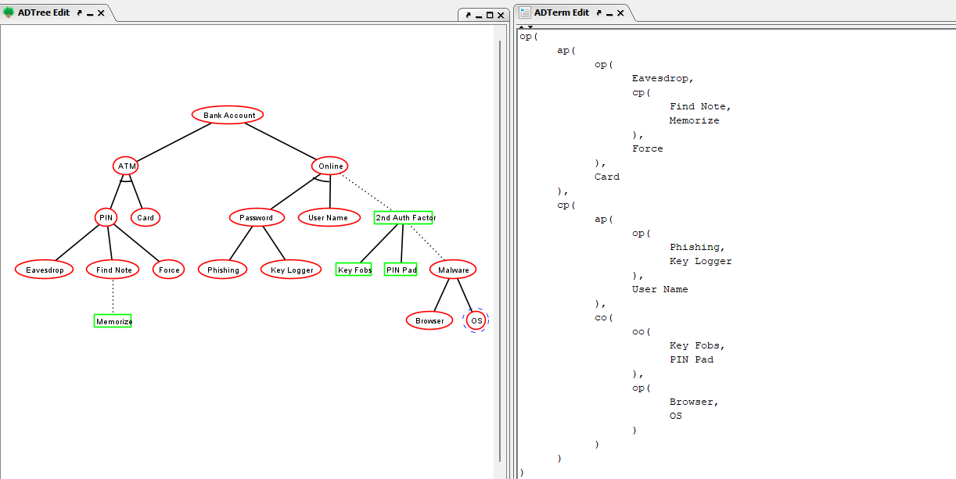

Slide 18
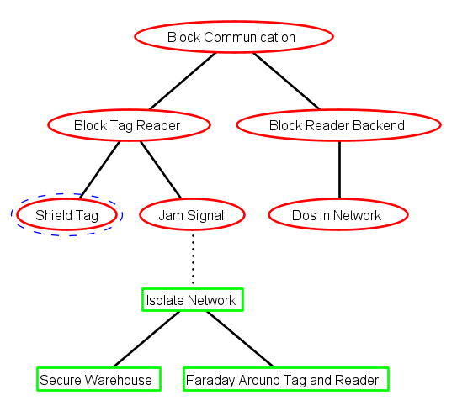
Exercise (tree translation)

Slide 19
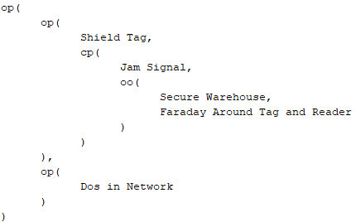
Exercise (tree translation)

Slide 20
Exercise (success probability for the nodes)
Standard quantitative analysis on the node success probability of ADTrees relies on a step-wise computation procedure.
Numerical values are assigned to all atomic actions, represented by the non-refined nodes
The values for the remaining nodes, including the root of the tree, are deduced automatically in a bottom-up way.

Slide 21
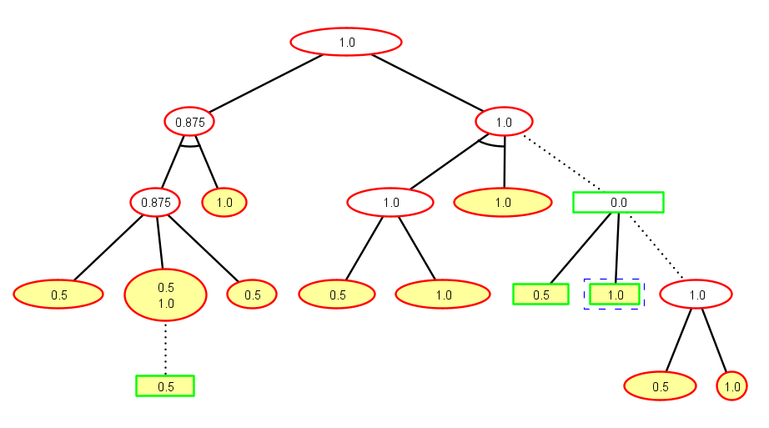
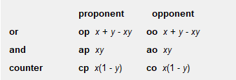
Exercise (success probability for the nodes)
0.75
1.0
0.0
1.0
0.5

Slide 22
Exercise (success probability for the nodes)
0.75
1.0
0.0
1.0
0.5

Slide 23
Exercise (success probability for the nodes)
0.75
1.0
0.0
1.0
0.75
0.5

Slide 24
Exercise (success probability for the nodes)
0.75
1.0
0.0
0.75+0.5-0.75*0.5
1.0
0.5

Slide 25
Exercise (success probability for the nodes)
0.75
1.0
0.0
0.75+0.5-0.75*0.5
1.0
0.5

Slide 26
Exercise (success probability for the nodes)
0.75
1.0
0.0
0.75+0.5-0.75*0.5
1.0
0.75
0.5

Slide 27
Exercise (success probability for the nodes)
0.75
1.0
0.0
0.75+0.5-0.75*0.5
1.0
0.75
0.5

Slide 28
Exercise (success probability for the nodes)
0.75
1.0
0.25
0.75+0.5-0.75*0.5
1.0
0.75
0.5

Slide 29
Exercise (success probability for the nodes)
0.75
1.0
0.25
0.75+0.5-0.75*0.5
1.0
0.75
0.5

Slide 30
Exercise (success probability for the nodes)
0.75
1.0
0.25
0.75+0.5-0.75*0.5
1.0
0.75
0.5

Slide 31
Exercise (success probability for the nodes)
0.75
1.0
0.25
0.75+0.5-0.75*0.5
1.0
0.75
0.5

Slide 32
Exercise (success probability for the nodes)
0.875+0.75-0.875*0.75
0.96875
0.75
1.0
0.25
0.75+0.5-0.75*0.5
1.0
0.75
0.5

Slide 33
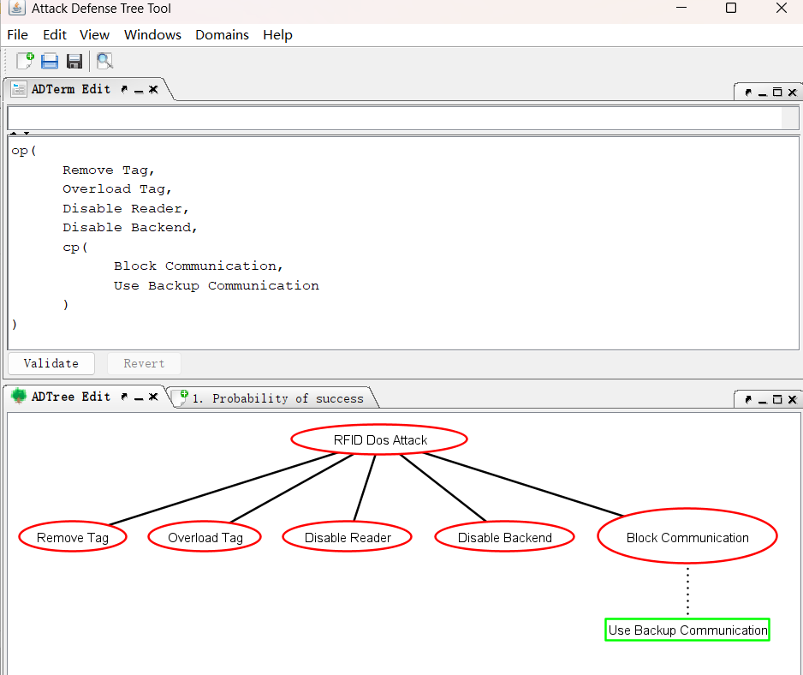
Exercise (success probability for the nodes)
Add Attribute Domain

Slide 34
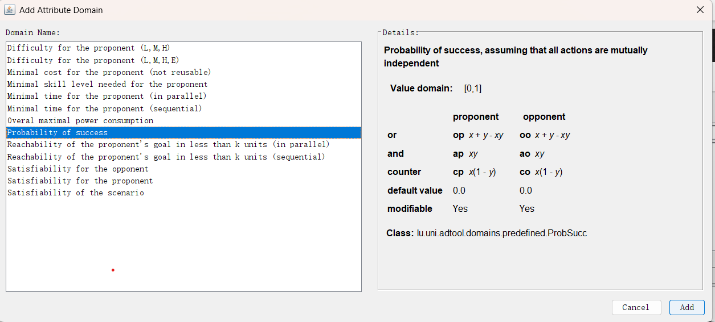
Exercise (success probability for the nodes)

Slide 35
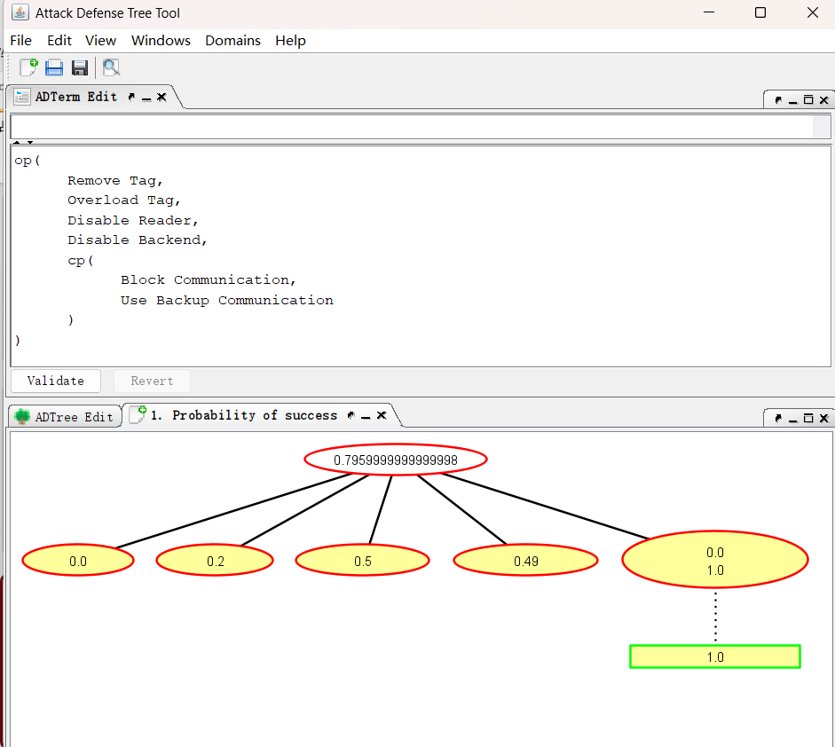
Exercise (success probability for the nodes)

Slide 36
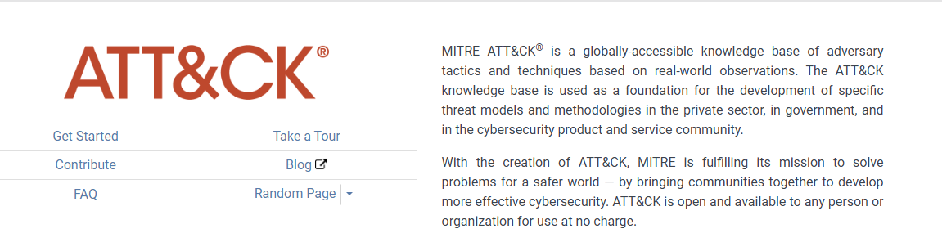
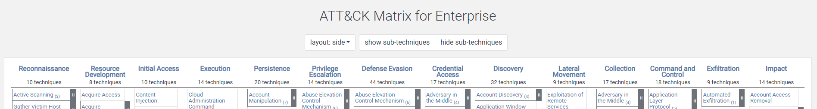
CALDERA
It is built on the MITRE ATT&CK™ framework and is an active research project at MITRE.

Slide 37
CALDERA
CALDERA provides a cyber-range environment. Cyber range simulates real-world network environment that can be used to replicate real-world cyber scenarios.
A red team can automate simulated attacks that are modelled from real-world threat actors, identify weaknesses in a target organization’s network and test the incident-response mechanisms that are deployed.
A blue team can inspect the effectiveness of their deployed defenses and incident-response mechanisms, thus improving their incident response capabilities, better preparing for real-world cyber threats and mitigating the risks associated with cyber attacks.

Slide 38
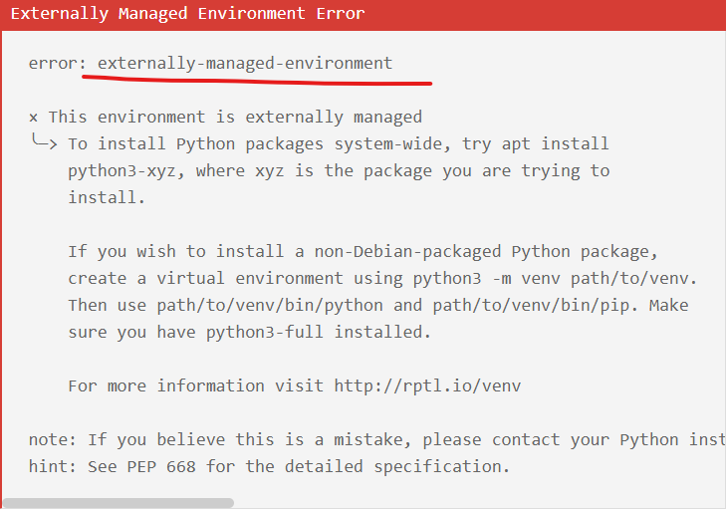
CALDERA
Installation
Open a Linux VM
Run the following commands:
sudo apt install python3-pip
git clone https://github.com/mitre/caldera.git --recursive
cd caldera
pip3 install -r requirements.txt
You can create python virtual environment
The other way is by appending --break-system-packages at the end

Slide 39
CALDERA
Installation
Open a Linux VM
Run the following commands:
sudo apt install python3-pip
git clone https://github.com/mitre/caldera.git --recursive
cd caldera
The other easy option is to use docker (Caldera needs python3.11) docker run -it -p 8888:8888 -v $(pwd):/caldera python:3.11 bash
Inside the container cd /caldera
pip install -r requirements.txt
for f in plugins/*/requirements.txt; do pip install -r "$f"; done
python server.py --insecure

Slide 40
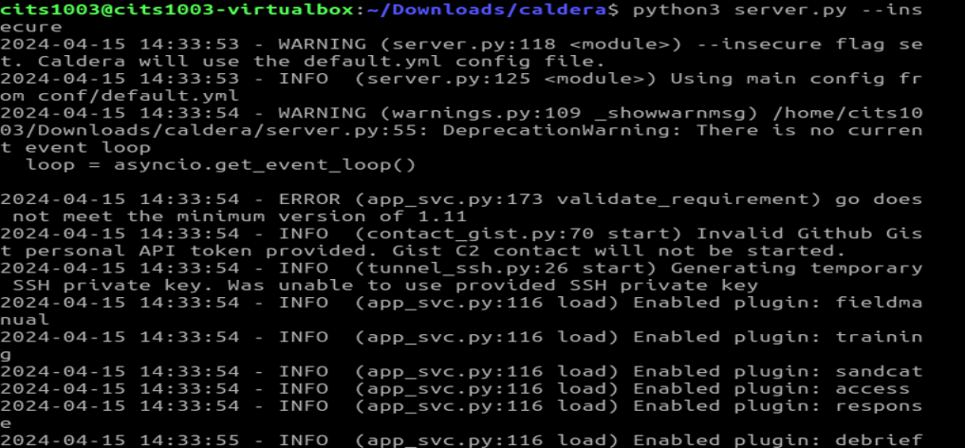
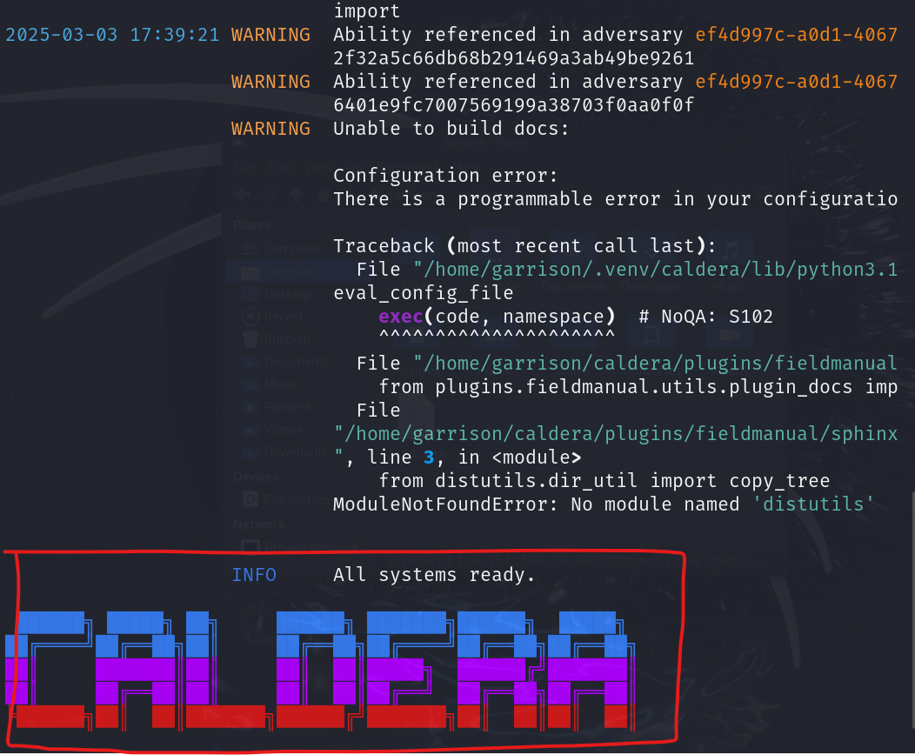
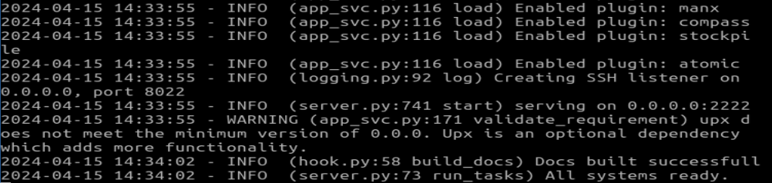

Slide 41
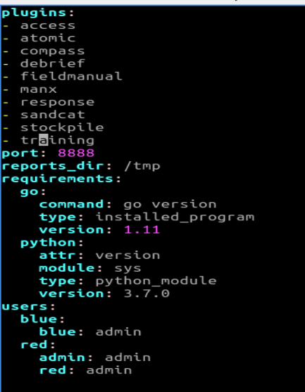
CALDERA
Login
In caldera/conf/default.vml,

Slide 42
CALDERA
Login
Open a browser
Enter the following URL in the address bar
http://localhost:8888
username: red
password: admin

Slide 43
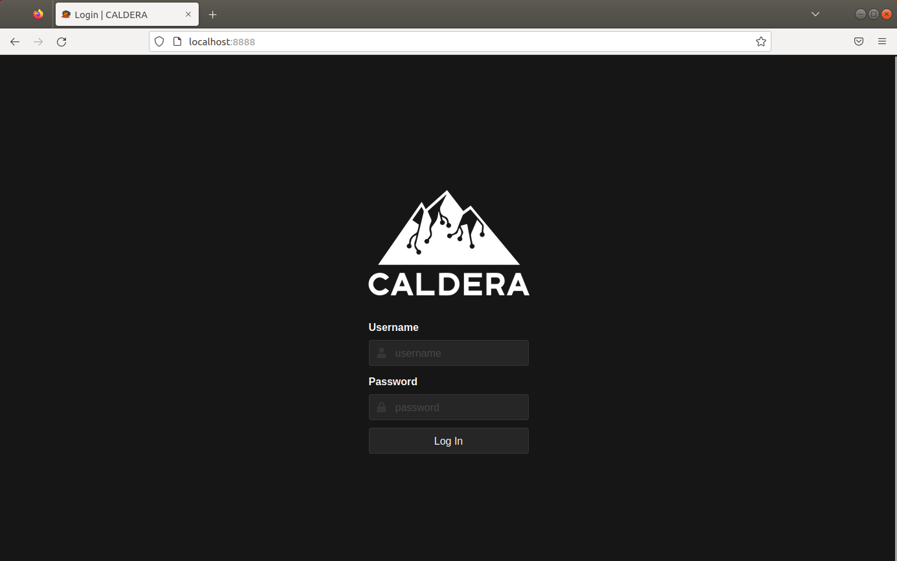
CALDERA

Slide 44
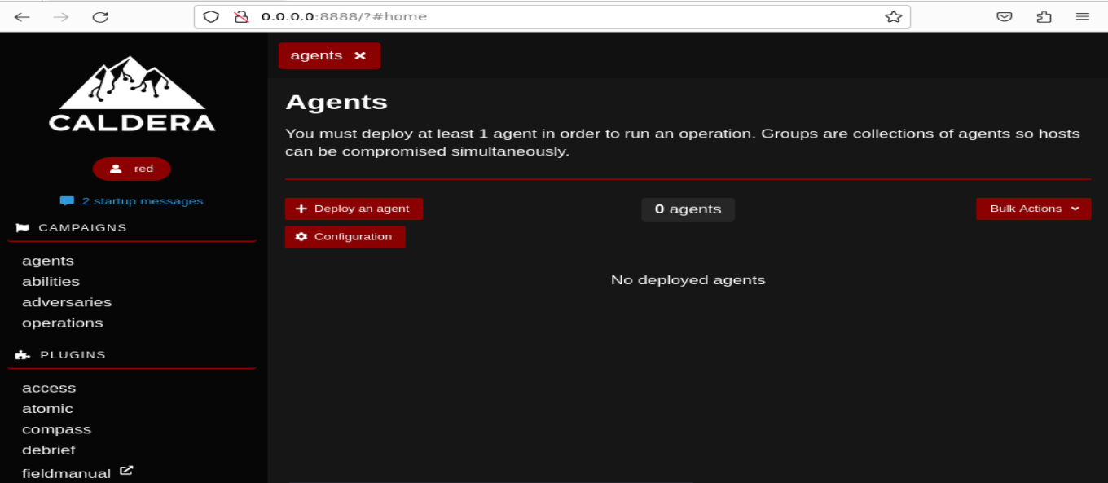
CALDERA

Slide 45
CALDERA
Adversary is a profile of instructions that describe various TTPs (Tactics, Techniques and Procedures) to be performed on a targeted system. An adversary profile can be used to simulate an attack automatically.

Slide 46
CALDERA
Tactic: high-level attack goal that attackers aim to achieve.
e.g., gaining unauthorized access.
Technique: specific method used by attackers to achieve a tactic.
e.g., exploiting vulnerabilities.
Procedure: step-by-step process followed by attackers when executing a technique.
e.g., specific Linux commands in each step.

Slide 47
CALDERA
Adversary is a profile of instructions that describe various TTPs to be performed on a targeted system. An adversary profile can be used to simulate an attack automatically.
Agent works as a spy program that is installed on the targeted system and responsible for executing TTPs specified in the adversary profile.

Slide 48
CALDERA
Adversary is a profile of instructions that describe various TTPs to be performed on a targeted system. An adversary profile can be used to simulate an attack automatically.
Agent works as a spy program that is installed on the targeted system and responsible for executing TTPs specified in the adversary profile.
Ability is a specific implementation of a tactic/technique including what commands to run and what OS the commands can run on.
e.g., display information about running processes in Linux by running ``ps –aux”

Slide 49
CALDERA
Adversary is a profile of instructions that describe various TTPs (tactics, techniques and procedures) to be performed on a targeted system. An adversary profile can be used to simulate an attack or evaluate the effectiveness of a security defense.
Agent works as a spy program that is installed on the targeted system and responsible for executing TTPs specified in the adversary profile.
Ability is a specific implementation of a tactic/technique including what commands to run and what OS the commands can run on.
Operation is to create an adversary profile and execute the profile via agent.

Slide 51
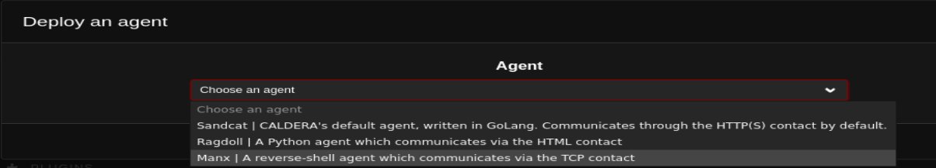

Slide 52
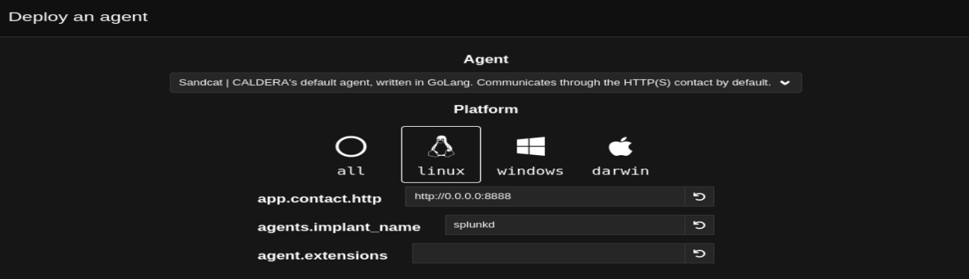
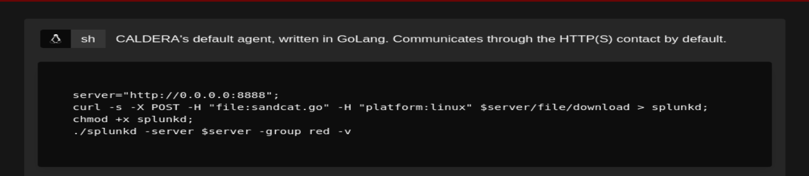

Slide 53

chmod +x agent.sh

Slide 54
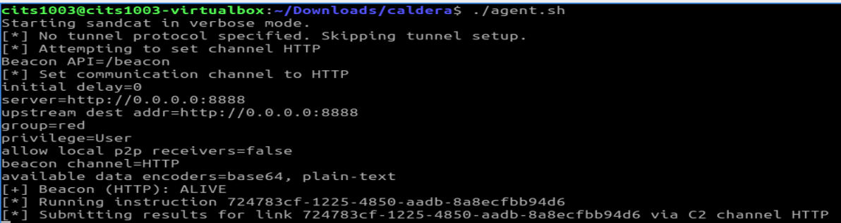

Slide 55
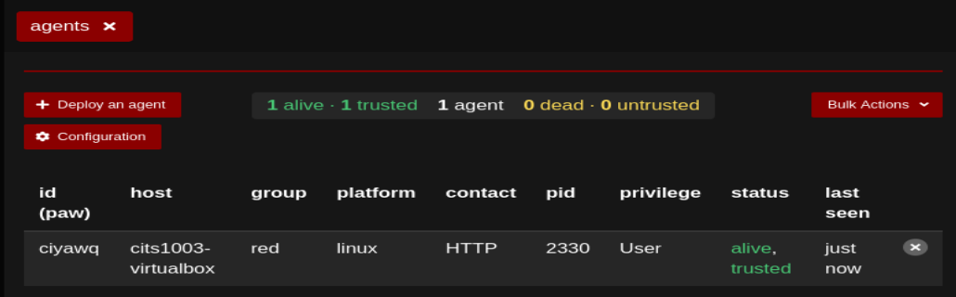

Slide 56
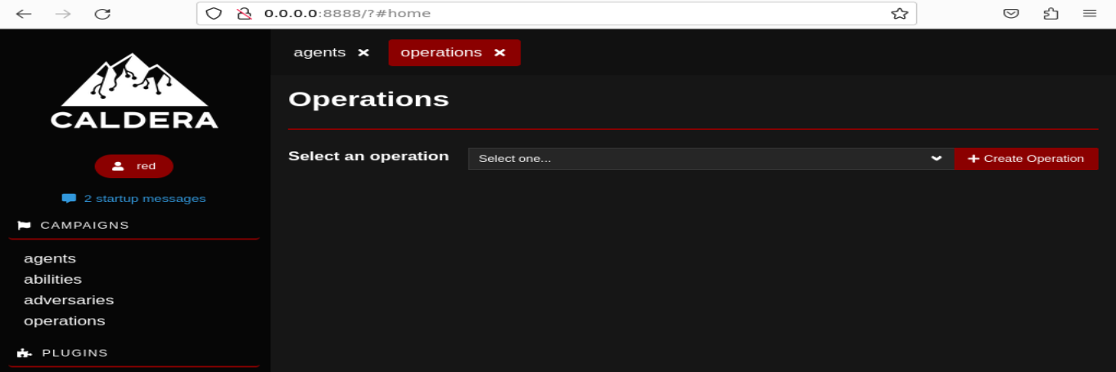

Slide 57
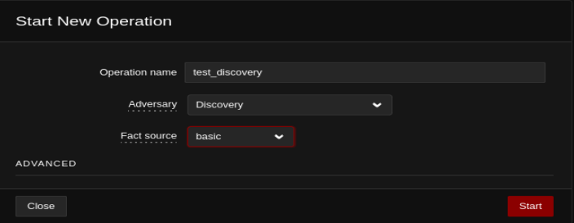

Slide 58
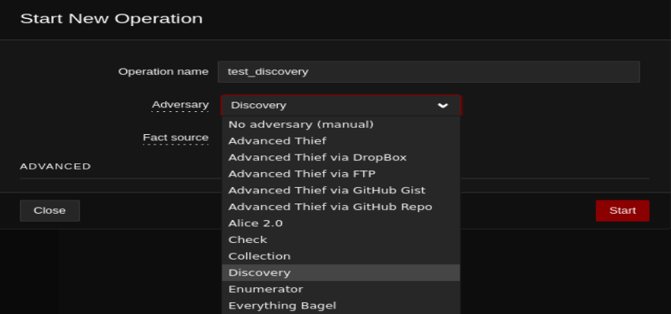
https://caldera.readthedocs.io/en/latest/plugins/stockpile/Exfiltration-How-Tos.html

Slide 59
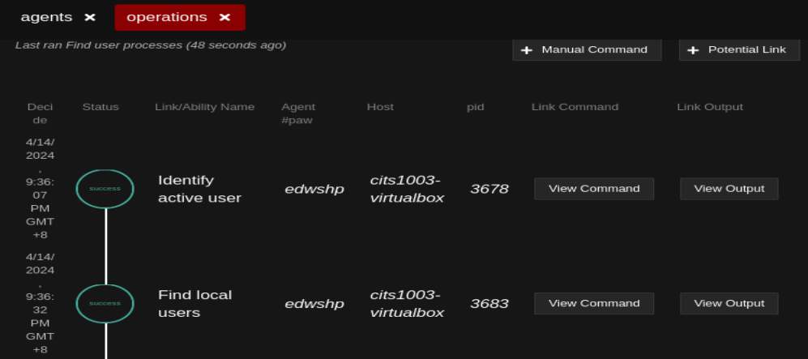

Slide 60
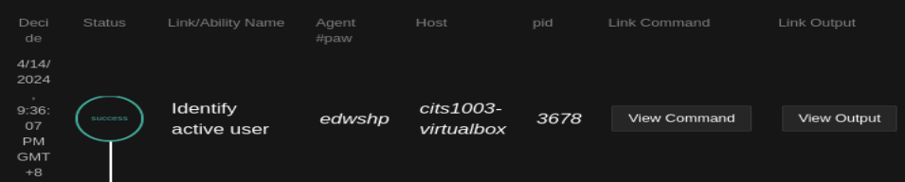
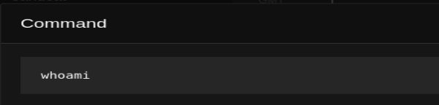
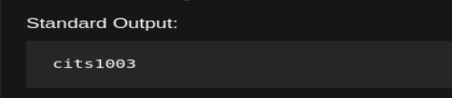

Slide 61
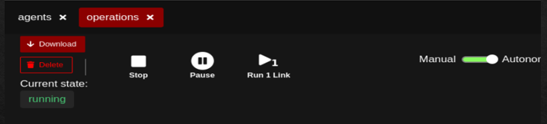
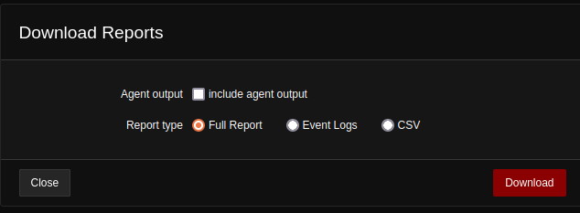

Slide 62
CALDERA
Demo

